Slide 1



Feature Selection and Engineering
INTRODUCTION TO MACHINE LEARNING
- Ashwina Rakish

Slide 2
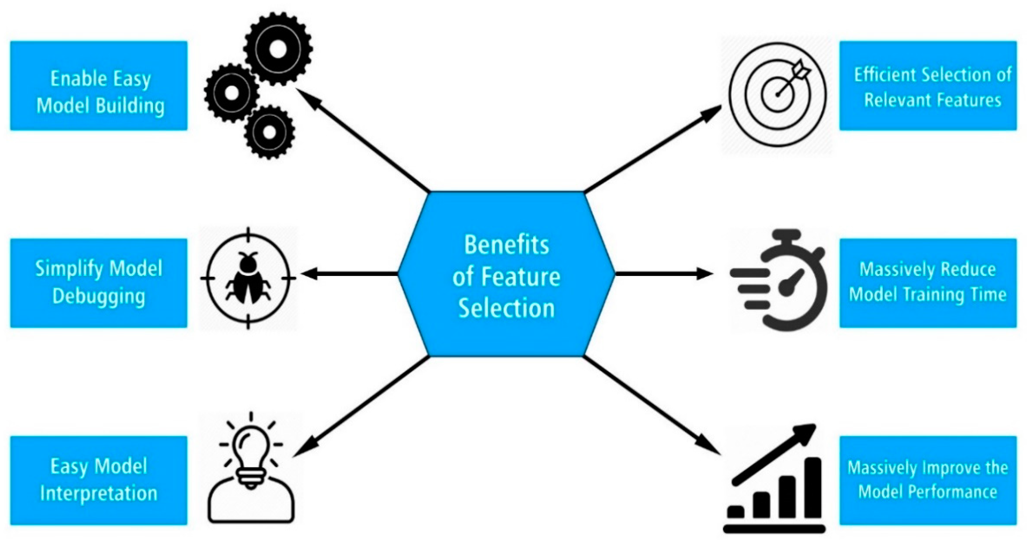
Feature Selection
Feature selection is the process of choosing a subset of relevant features for use in model construction. It aims to improve the model's performance by reducing overfitting, increasing accuracy, and speeding up training time.

Slide 3
Types of Feature Selection
1. Filter Methods: These methods select features based on statistical properties like correlation with the target variable, variance, or mutual information. Examples include Pearson correlation coefficient, chi-square test, and ANOVA.
2. Wrapper Methods: These methods evaluate different subsets of features by training the model on various combinations and selecting the subset that yields the best performance. Examples include forward selection, backward elimination, and recursive feature elimination.
3. Embedded Methods: These methods perform feature selection as part of the model training process. Techniques like Lasso regression and decision tree-based algorithms (e.g., Random Forest) inherently perform feature selection during model training.

Slide 4
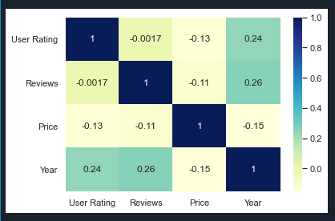
Correlation Coefficient(Filter Method)
Two factors need to be considered:
1) Variables need to be highly correlated to the target variable(variable being predicted).
2) Selected feature variables should not be correlated to each other.
If two variables are correlated, we can predict one from the other. Therefore, if two features are correlated, the model only needs one, as the second does not add additional information.

Slide 5
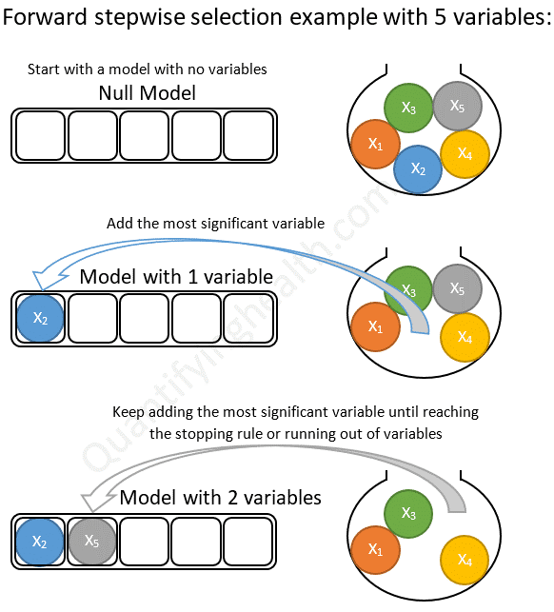
Forward Selection (Wrapper Method)
Forward step selection is a feature selection method that starts with no features and iteratively adds the most promising feature based on a predefined criterion until a stopping condition is met.
1) Initialize: Start with no features selected. 2) Evaluate: Score all the features based on performance.
3) Select: Choose the feature with the highest score and add it to the set.
4) Train: Train a model using the selected features.
5) Evaluate Criterion: Assess model performance.
6) Check Stopping Criterion: If met, stop; otherwise, repeat from step 2.

Slide 6
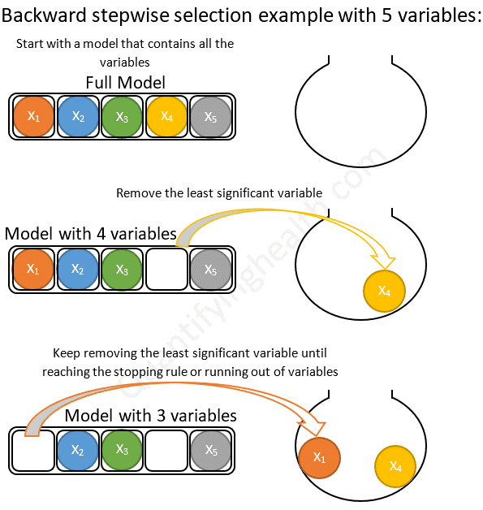
Backward Elimination(Wrapper Method)
Backward step selection is a feature selection method that starts with all features and iteratively removes the least promising feature based on a predefined criterion until a stopping condition is met. The steps are:
1) Initialize: Start with all features selected.
2) Evaluate: Score each feature.
3) Select: Choose the feature with the lowest score and remove it from the set.
4) Train: Train a model using the remaining features.
5) Evaluate Criterion: Assess model performance.
6) Check Stopping Criterion: If met, stop; otherwise, repeat from step 2.

Slide 7
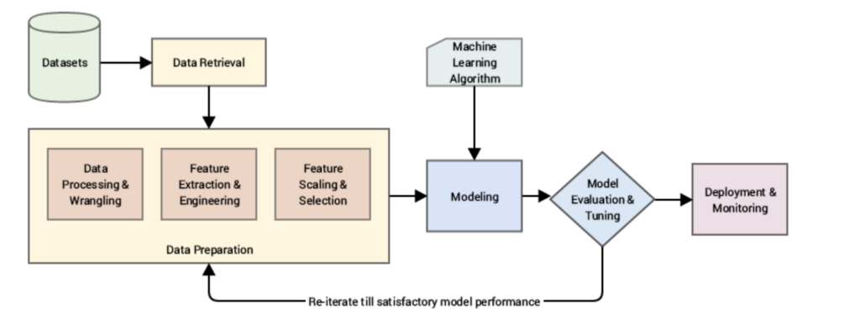
Feature Engineering
Feature engineering, in data science, refers to manipulation addition, deletion, combination, mutation of your data set to improve machine learning model training, leading to better performance and greater accuracy.

Slide 8
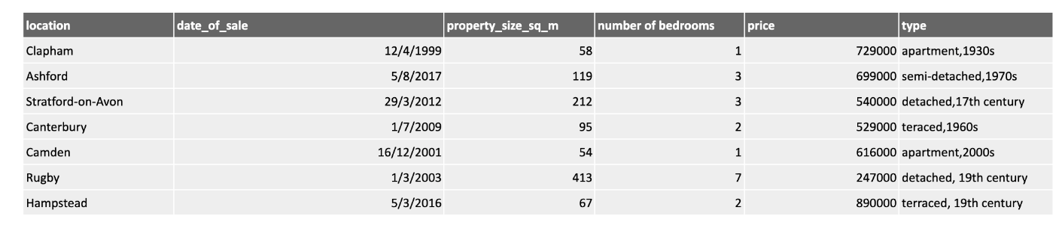
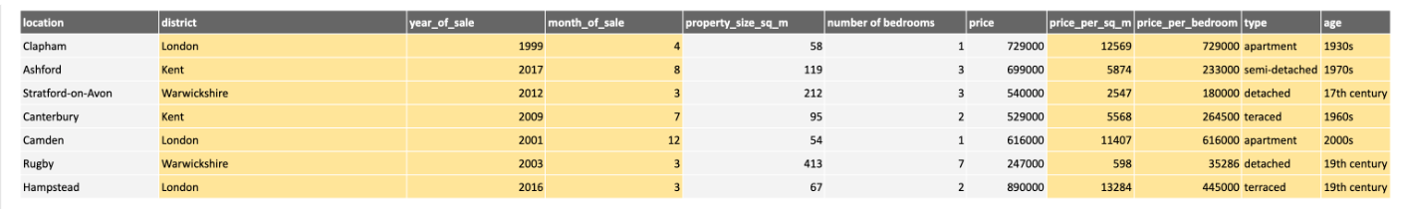
Feature Creation

Slide 9
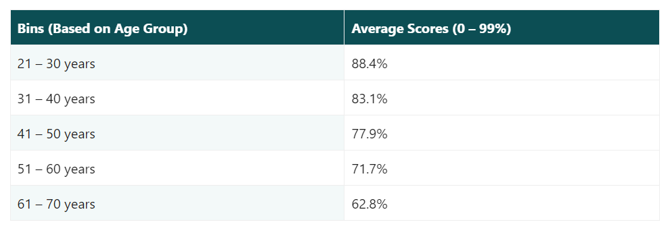
Binning
Binning in feature engineering is a technique used to transform continuous numerical variables into categorical variables by grouping them into bins or intervals. This process is also known as discretization.

Slide 10
QUIZ

Slide 11
Question: Which of the following best describes the correlation coefficient in feature selection? (a) It measures the linear dependence between two features. (b) It directly removes irrelevant features from the dataset. (c) It assigns weights to features based on their importance. (d) It cannot be used for feature selection.
Answer: (a)

Slide 12
Question: Forward selection in feature selection involves: (a) Starting with all features and removing the least relevant one iteratively. (b) Starting with no features and adding the most relevant one iteratively. (c) Identifying and removing highly correlated features. (d) Transforming features into a lower-dimensional space.
Answer: (b)

Slide 13
Question: Backward elimination in feature selection refers to: (a) Starting with all features and keeping only the most relevant ones. (b) Starting with no features and iteratively adding relevant ones. (c) Scaling features to a common range. (d) Creating new features from existing ones.
Answer: (a)

Slide 14
Question: Binning in feature engineering involves: (a) Removing irrelevant features from the dataset. (b) Discretizing a continuous feature into a set of intervals. (c) Assigning weights to features based on their importance. (d) Transforming features into a completely new representation.
Answer: (b)

Slide 15
Question: Feature creation involves: (a) Removing redundant information from existing features. (b) Combining existing features to create new informative features. (c) Scaling features to a common range. (d) Selecting the most relevant features for model training.
Answer: (b)

Slide 16
Question: If the correlation coefficient values of features are the following: x1 = 0.99, x2 = 0.67, x3 = 0, x4 = -0.89 Select the two best features among x1,x2,x3 and x4.
Answer: x1, x4

Slide 17
Question: True or False: Different problems in the same domain may need different features.
Answer: True

Slide 18
Thank You!

